Slide 1


School of Computer Science & IT Department of BCA
Security Standards
MODULE 1: Introduction to networking standards (20BCA5S42)
Faculty : Prachi Gupta

Slide 2
What Is Networking?
For such an extensive and involved subject that includes so many different technologies, hardware devices, and protocols, networking is actually quite simple.
A network is simply a collection of computers or other hardware devices that are connected together, either physically or logically, using special hardware and software that allows the devices to exchange information and cooperate.
Networking is the term that describes the processes involved in designing, implementing, upgrading, managing, and otherwise working with networks and network technologies.
Each time you pick up a phone, use a credit card at a store, get cash from an ATM machine, or even plug in an electrical appliance, you are using some
The definition can even be expanded beyond the world of technology. The term networking used to describe the process of finding an employer or employee through friends and associates.
Similarly, the idea here is that independent units are connected together to share information and cooperate.

Slide 3
What Is Networking?
The widespread networking of personal computers is a relatively new phenomenon.
For the first decade or so of their existence, PCs were very much "islands unto themselves," and were rarely connected together.
In the early 1990s, PC networking began to grow in popularity as businesses realized the advantages that networking could provide.
By the late 1990s, networking in homes with two or more PCs really started to take off as well.
This interconnection of small devices represents, in a way, a return to the good old days of mainframe computers.
Before computers were small and personal, they were large and centralized machines that many users operating remote terminals shared.
Although having all of that computer power in one place had many disadvantages, one benefit was that all users were connected because they shared the central computer.

Slide 4
What Is Networking?
Individualized PCs took away that advantage.
Networking attempts to move computing to a middle ground. It provides PC users with the best of both worlds: the independence and flexibility of personal computers, and the connectivity and resource sharing of mainframes.
In fact, networking today is considered so vital that it's hard to conceive of an organization with two or more computers that would not want to connect them together!

Slide 5
The Advantages and Benefits of Networking
A network isn't just a bunch of computers with wires running between them.
Properly implemented, a network is a system that provides its users with unique capabilities, above and beyond what the individual machines and their software applications can provide.
Most of the benefits of networking can be divided into two basic categories: connectivity and sharing
Networks allow computers, and hence their users, to connect to each other.
They also allow for the easy sharing of information and resources, and for the simple cooperation between the devices in other ways.
Since modern business depends so much on the intelligent flow and management of information, this ease of use tells you a lot about why networking is so valuable.

Slide 6
The Advantages and Benefits of Networking
Some of the specific advantages generally associated with networking:
Connectivity and Communication
Networks connect computers and the users of those computers.
Individuals within a building or workgroup can be connected through local area networks (LANs); LANs in distant locations can be interconnected to form larger, wide area networks (WANs).
Once computers are connected, it is possible for network users to communicate with each other using technologies such as electronic mail.
This makes the transmission of business (or nonbusiness) information easier, more efficient, and less expensive than it would be without the network.
Data Sharing
One of the most important uses of networking is to allow the sharing of data.
Before networking was common, an accounting employee who wanted to prepare a report for her manager would have to produce it on her PC, put it on a floppy disk, and then walk it over to the manager, who would transfer the data to her PC's hard disk.

Slide 7
The Advantages and Benefits of Networking
Data Sharing
True networking allows thousands of employees to share data much more easily and quickly than this.
It also makes possible applications that enable many people to access and share the same data, such as databases, group software development, and much more.
Hardware Sharing
Networks facilitate the sharing of hardware devices.
For example, instead of giving each employee in a department an expensive color printer (or resorting to the sneakernet again), you can place one printer on the network for everyone to share.
Internet Access
The Internet is itself an enormous network, so whenever you access the Internet, you are using a network.
The significance of the Internet today is hard to exaggerate!

Slide 8
The Advantages and Benefits of Networking
Internet Access Sharing
Small computer networks allow multiple users to share a single Internet connection.
Special hardware devices allow the bandwidth of the connection to be easily allocated to various individuals as they need it, and these devices permit an organization to purchase one high-speed connection instead of many slower ones.
Data Security and Management
In a business environment, a network allows the administrators to manage the company's critical data better.
Instead of spreading data over dozens or even hundreds of small computers in a haphazard fashion as users create it, administrators can centralize data on shared servers.
This makes it easy for everyone to find the data and makes it possible for the administrators to ensure that the data is regularly backed up.
Administrators can also implement security measures to control who can read or change various pieces of critical information.
Performance Enhancement and Balancing
Under some circumstances, you can use a network to enhance the overall performance of some applications by distributing the computation tasks to various computers on the network.

Slide 9
The Advantages and Benefits of Networking
Entertainment
Networks facilitate many types of games and entertainment.
The Internet itself offers many sources of entertainment.
In addition, many multiplayer games operate over a LAN.
Many home networks are set up for this reason, and gaming across WANs (including the Internet) has also become quite popular.
if you are running a business and have employees who are easily amused, you might insist that this is really a disadvantage of networking rather than an advantage!

Slide 10
The Disadvantages and Costs of Networking
Network Hardware, Software, and Setup Costs
Setting up a network requires an investment in hardware and software, as well as funds for planning, designing, and implementing the network.
For a home with a small network of two or three PCs, this is relatively inexpensive.
It amounts to more or less a hundred dollars with today's low prices for network hardware, and practically no setup costs considering that the operating systems have already been designed for networks.
For a large company, however, costs can easily run into tens of thousands of dollars or more.
Hardware and Software Management and Administration Costs
In all but the smallest of implementations, ongoing maintenance and management of the network requires the care and attention of an IT professional.
In a smaller organization that already has a system administrator, a network may fall within this person's job responsibilities, but it will take time away from other tasks.
In more substantial organizations, a network administrator may need to be hired, and in large companies an entire department may be necessary.

Slide 11
The Disadvantages and Costs of Networking
Undesirable Sharing
With the good comes the bad; though networking allows the easy sharing of useful information, it also allows the sharing of undesirable data.
One significant sharing problem in this regard has to do with viruses, which are easily spread over networks and the Internet.
Mitigating these effects costs time, money, and administrative effort.
Illegal or Undesirable Behavior
Similar to the previous point, networking facilitates useful connectivity and communication, but also brings difficulties with it.
Typical problems include the abuse of company resources, distractions that reduce productivity, the downloading of illegal or illicit materials, and even software piracy.
In larger organizations, these issues must be managed through explicit policies and monitoring, which, again, further increases management costs.

Slide 12
The Disadvantages and Costs of Networking
Data Security Concerns
If a network is implemented properly, it is possible to greatly improve the security of important data.
In contrast, a poorly secured network puts critical data at risk, exposing it to the potential problems associated with hackers, unauthorized access, and even sabotage.
Most of these costs and potential problems can be managed by those who set up and run networks.
In the end, the choice of whether to use a network is a matter of weighing the advantages against the disadvantages.
Today, nearly everyone decides that networking is worthwhile.

Slide 13
Fundamental Network Characteristics
There are many different kinds of networks and network technologies that are used to create
Different needs require different solutions.
The drawback of this is that there are so many different types of protocols and technologies for the networking student to understand!
Before you can really compare these approaches, you need to understand some of the basic characteristics that make networks what they are.
Although network types may be quite dissimilar, they are often described and even contrasted on the basis of a number of common attributes.
Networking Layers, Models, and Architectures
One of the reasons why many people find networking difficult to learn is that it can be a very complicated subject.
One of the chief reasons for this complexity is that networks consist of so many hardware and software elements.
While a network user may perceive that he is using only one computer program (like a web browser) and one piece of hardware (like a PC), these are parts of a much larger puzzle.
In order for even the simplest task to be accomplished on a network, dozens of different components must cooperate by passing control information and data to accomplish the overall goal of network communication.

Slide 14
Fundamental Network Characteristics
Networking Layers, Models, and Architectures
The best way to understand any complex system is to break it down into pieces and then analyze what those pieces do and how they interact.
The most logical approach is to divide the overall set of functions into modular components, each of which is responsible for a particular function.
At the same time, you also need to define interfaces between these components, which describe how they fit together.
This enables you to simplify the complexity of networking by approaching it in digestible chunks.
Networking technologies are most often compartmentalized in this manner by dividing their functions into layers, each of which contains hardware and software elements.
Each layer is responsible for performing a particular type of task and interacts with the layers above and below it.
Layers are conceptually arranged into a vertical stack.

Slide 15
Fundamental Network Characteristics
Networking Layers, Models, and Architectures
Lower layers are charged with more concrete tasks such as hardware signaling and low-level communication; they provide services to the higher layers.
The higher layers, in turn, use these services to implement more abstract functions such as implementing user applications.
Dividing networks into layers this way is somewhat like the division of labor in a manufacturing facility, and it yields similar benefits.
Each hardware device or software program can be specialized to perform the function needed by that layer, like a well-trained specialist on an assembly line.
The different modules can be combined in different ways as needed.
This way, it's also easier to understand how a network functions overall.
One other important benefit of layering is that makes it possible for technologies defined by different groups to interoperate.
For this to be possible, it is necessary for everyone to agree on how layers will be defined and used.
The most common tool for this purpose is a networking model.

Slide 16
Fundamental Network Characteristics
Networking Layers, Models, and Architectures
The model describes what the different layers are in the network, what each is responsible for doing, and how they interact.
A universally accepted model ensures that everyone is on the same page when creating hardware and software.
The most common general model in use today is the Open Systems Interconnection (OSI) Reference Model, which consists of seven stacked layers.
These range from the physical layer (layer 1) at the bottom, which is responsible for low-level signaling, to the application layer (layer 7) at the top, where application software is implemented.
Understanding the OSI model is essential to understanding networking as a whole.
Closely related to the concept of a model is the concept of an architecture.
An architecture is essentially a set of rules that describes the function of some portion of the hardware and software that constitutes a stack of layers.
Such a ruleset usually takes the form of a specification or standard that describes how equipment and programs using the technology must behave.
A networking architecture is designed to implement the functions associated with a particular contiguous set of layers of the OSI Reference Model, either formally or informally.

Slide 17
Network Standards
Networking standards define the rules for data communications that are needed for interoperability of networking technologies and processes. Standards help in creating and maintaining open markets and allow different vendors to compete on the basis of the quality of their products while being compatible with existing market products.
During data communication, a number of standards may be used simultaneously at the different layers. The commonly used standards at each layer are −
Application layer − HTTP, HTML, POP, H.323, IMAP
Transport layer − TCP, SPX
Network layer −IP, IPX
Data link layer − Ethernet IEEE 802.3, X.25, Frame Relay
Physical layer −RS-232C (cable), V.92 (modem)

Slide 18
Network Standards
The Importance of Standards
Standards are necessary in almost every business and public service entity. For example, before 1904, fire hose couplings in the United States were not standard, which meant a fire department in one community could not help in another community. The transmission of electric current was not standardized until the end of the nineteenth century, so customers had to choose between Thomas Edison’s direct current (DC) and George Westinghouse’s alternating current (AC).
The primary reason for standards is to ensure that hardware and software produced by different vendors can work together. Without networking standards, it would be difficult—if not impossible—to develop networks that easily share information. Standards also mean that customers are not locked into one vendor. They can buy hardware and software from any vendor whose equipment meets the standard. In this way, standards help to promote more competition and hold down prices.
The use of standards makes it much easier to develop software and hardware that link different networks because software and hardware can be developed one layer at a time.

Slide 19
Network Standards
Types of standards
Proprietary Standards
In the early days of computing, many people didn't quite understand just how important universal standards were.
Most companies were run by skilled inventors, who came up with great ideas for new technologies, but who weren't particularly interested in sharing them.
It wasn't considered a smart business move to share information about new inventions with other companies—the competition
companies believed that standards were important, but they thought it was even more important that they be the ones to control those standards
For example, imagine that it's 1985, and I have just come up with a great networking technology, which I have incorporated into a fancy new local area networking (LAN) product called SooperDooperNet. SooperDooperNet is my product. I have patents on the technology, I control its design and manufacture, and I sure as heck don't tell anyone else how it works, because if I did, someone would copy me.

Slide 20
Network Standards
Types of standards
Proprietary Standards
I could sell interface cards, cables, and accessories for SooperDooperNet, and companies that wanted to use it could install the cards in all of their PCs and be assured that those computers would be able to talk to each other.
This solves the interoperability problem for this company by creating a "SooperDooperNet” standard." This would be an example of a proprietary standard—it's owned by one company or person.
proprietary standards is that other companies are excluded from the standard development process, and therefore have little incentive to cooperate with the standard owner
They have a strong motivation to develop a competing proprietary standard, even if it doesn't improve on the existing one.
So when my competition sees what I am doing, he is not going to also create network interface cards that can work with SooperDooperNet, which would require paying me a royalty.

Slide 21
Network Standards
Types of standards
Proprietary Standards
Instead, he is going to develop a new line of networking hardware called MegaAwesomeNet, which is very similar to SooperDooperNet in operation but uses different connectors, cable, and logic.
He, too, will try to sell bunches of cards and cables to my customers.
The problem here is that the market ends up with different companies using different products that don't work together.
If you install SooperDooperNet, you have to come to me for any upgrades or changes—you have no choice.
Worse, what happens if Acme Manufacturing, which has 50 PCs running SooperDooperNet, merges with Emca Manufacturing, which has 40 PCs running MegaAwesomeNet? The IT people have a problem. Sure, there would be ways to solve it, but wouldn't everyone be better off avoiding these difficulties in the first place? And how could you create something like the Internet if everyone's networks use different "standards"?
eg,. windows

Slide 22
Network Standards
Types of standards
Open Standards
Eventually, companies learned that they would be better off with standards that everyone agreed on.
This is particularly true of networking, where devices need to talk to each other.
If many companies get together and agree to cooperate, they can create an open standard instead of a bunch of proprietary ones.
The name is rather self-explanatory; rather than being the closely guarded secret of one organization, an open standard is available to anyone who is interested in using it.
One key to the success of an open standard is a steering organization to promote it.
Usually, a neutral, nonprofit trade association or working group is established to develop the standard, and the various for-profit hardware and software companies join this group and support it financially.
These groups also work with standards approval bodies like the International Telecommunication Union (ITU) and International Organization for Standardization (ISO) to gain acceptance for their standards.

Slide 23
Network Standards
Types of standards
Open Standards
Of course, the companies aren't doing this just to be nice to their customers.
In creating open standards, they split the market-share pie among them, but they make the pie grow much larger by attracting more customers.
Customers like open standards more than proprietary ones, because those standards give them more choices and increase their ability to interact with other companies, troubleshoot problems, hire skilled workers, and expand in the future.
As for the companies, they still compete with their specific offerings, so it's not like they all end up making the same products. For all of these reasons, open standards are now far more common than proprietary ones.
However, the process involved in creating these standards is often a difficult one.
In some cases, the standards organization will draft the standard from the ground up, but in others, it may select one technology as the basis for the standard from several that are submitted in what is commonly called a "technology bake-off."

Slide 24
Network Standards
Types of standards
Open Standards
Thus, many different companies may come to the table with different approaches, each of them vying for selection as the standard for use by the group.
Politics can cause groups to get bogged down for years fighting over various options, or even to split into multiple groups.
Good examples are what occurred in the conflict between supporters of 100VGAnyLAN and Fast Ethernet, and the problems with standards politics that have plagued the world of powerline networking.
Furthermore, there are still some companies that believe strongly in proprietary standards, because they really want to control and direct the market.
One of the most famous (infamous) in this regard is Sony, a company that makes excellent hardware but frequently refuses to accept established standards.
For this reason, some people avoid Sony's products, even though they are good, because they want to stick to industry standards.

Slide 25
Network Standards
Types of standards
De Facto Standards
"De facto" is Latin for "in fact.“
A de facto standard is one that is used as a universal standard just because, over time, it has been widely used, and not because the standard was developed and approved by a standards committee.
A good example of a de facto standard is the AT command set used by modems.
Virtually all modems use it, but this acceptance didn't result from an industry group agreeing to adopt and deploy it.
Rather, it was developed unilaterally by Hayes, the pioneering modem company, and then adopted by virtually every other modem maker until it became a standard.
One reason why proprietary standards are still sometimes seen is that some companies want to produce a standard that will become so universally used that it becomes the de facto standard, thus giving them a leadership position in that market.
Again, in my estimation, Sony falls into this category—the developers often want to do things their way and create proprietary standards that they try to promote using their powerful market presence.

Slide 26
Network Standards
Types of standards
De Facto Standards
Sometimes this succeeds, but often it does not, resulting in a fragmented market of incompatible products. An excellent example is when Sony created a new format for a digital camera's flash memory (the Memory Stick) rather than using the CompactFlash format used by other camera manufacturers.
The end result was that not everyone used memory sticks as Sony had hoped, and there were now two incompatible standards that increased confusion and yielded no real benefit to the customer.

Slide 27
Network Standards
Networking Standards
All networking technologies have standards associated with them.
These are usually highly technical documents, and they often presume that the reader has a fair bit of knowledge about networking.
In fact, many technologies have quite a number of standards associated with them. A networking technology may have more than one standard for any or all of the following reasons:
The original standard has been revised or updated.
The technology is sufficiently complex that it needs to be described in more than one document.
The technology borrows from or builds on documents used in related technologies.
More than one organization has been involved in developing the technology.

Slide 28
Network Standards
Standards documents created in the United States are usually developed in English, but are also routinely translated into other languages.
European standards are often published simultaneously in English, French, German, and perhaps other languages as well.
International Networking Standards Organizations
The rise of open standards has been a great boon to customers of computer and networking products, as well as to the manufacturers that sell to them.
In order to facilitate the development of open standards, however, we need organizations that will coordinate the creation and publishing of these documents.
Generally, these are nonprofit organizations that specifically take a neutral stance regarding technologies and work for the betterment of the industry as a whole.

Slide 29
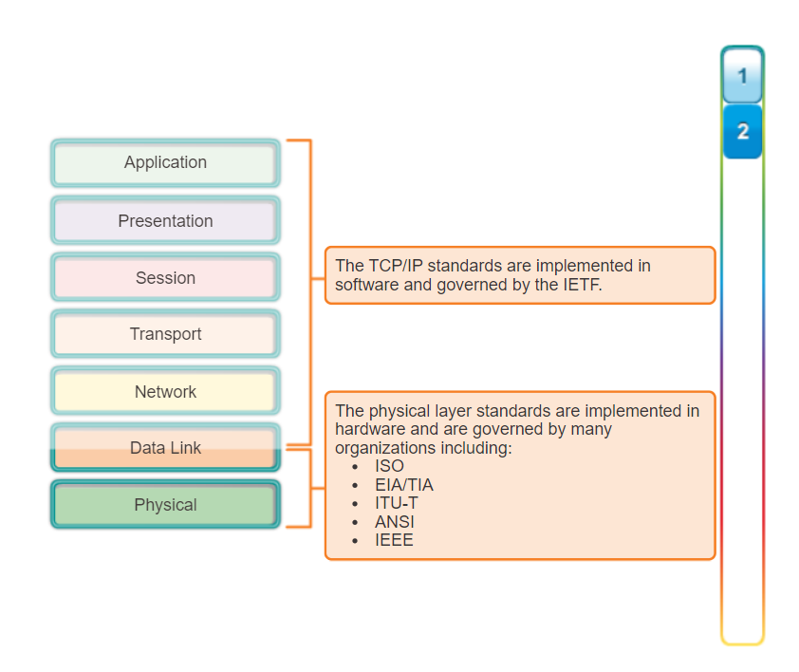
Network Standards

Slide 30
Network Standards
International Organization for Standardization (ISO)
Probably the biggest standards organization in the world, the ISO is really a federation of standards organizations from dozens of nations.
In the networking world, the ISO is best known for its OSI Reference Model
American National Standards Institute (ANSI)
ANSI is the main organization responsible for coordinating and publishing computer and information technology standards in the United States.
Although many people think that this organization develops and maintains standards, it does neither.
Instead, it oversees and accredits the organizations that actually create the standards, qualifying them as Standards Developing Organizations or SDOs.
ANSI also publishes the standards documents created by the SDOs and serves as the United States' representative to the ISO.
Information Technology Industry Council (ITIC)
ITIC is a group of several dozen companies in the information technology (computer) industry.
ITIC is the SDO approved by ANSI to develop and process standards related to many computer-related topics.
It was formerly known as the Computer and Business Equipment Manufacturers Association (CBEMA).

Slide 31
Network Standards
National Committee for Information Technology (NCITS)
NCITS is a committee established by the ITIC to develop and maintain standards related to the information-technology world.
NCITS was formerly known by the name Accredited Standards Committee X3, Information Technology, or more commonly, just X3.
It maintains several subcommittees that develop and maintain standards for various technical subjects.
Institute of Electrical and Electronics Engineers (IEEE)
The IEEE is a well-known professional organization for those in the electrical or electronics fields, including computers and networking.
IEEE's main claim to fame in the networking industry is the IEEE 802 Project, which encompasses many popular networking technologies, including Ethernet.
Electronic Industries Alliance (EIA)
The EIA is an international industry association that is best known for publishing electrical wiring and transmission standards.

Slide 32
Network Standards
Telecommunications Industry Association (TIA)
The TIA is the communications sector of the EIA, and it is responsible for developing communications standards.
Since communications, wiring, and transmission are all related, and since the TIA and EIA organizations are also related, standards produced by the EIA or TIA are often labeled with the combined prefixes EIA/TIA or TIA/EIA.
International Telecommunication Union—Telecommunication Standardization Sector (ITU-T)
ITU-T is another large international body that develops standards for the telecommunications industry.
The ITU-T was formerly named the International Telephone and Telegraph Consultative
European Telecommunications Standards Institute (ETSI)
An organization with members from dozens of countries both within and outside Europe that is dedicated to developing telecommunications standards for the European market
ETSI is known for, among other things, regulating the use of radio bandwidth in Europe and developing standards such as HiperLAN.

Slide 33
Network Standards
ISO
ISO (the International Organization for Standardization) and IEC (the International Electrotechnical Commission) form the specialized system for worldwide standardization.
National bodies that are members of ISO or IEC participate in the development of International Standards through technical committees established by the respective organization to deal with particular fields of technical activity.
ISO and IEC technical committees collaborate in fields of mutual interest.
Other international organizations, governmental and non-governmental, in liaison with ISO and IEC, also take part in the work.
In the field of information technology, ISO and IEC have established a joint technical committee, ISO/IEC JTC 1.

Slide 34
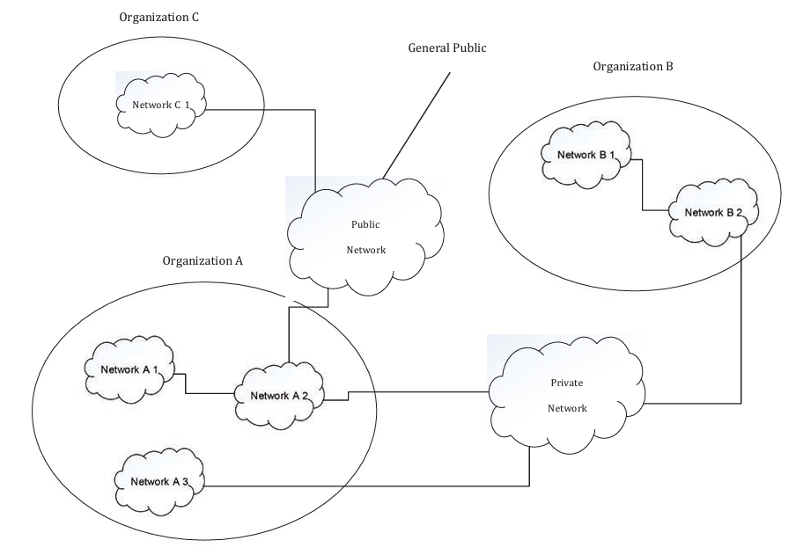
Network Standards
ISO -ISO/IEC 27033
the majority of both commercial and government organizations have their information systems connected by networks with the network connections being one or more of the following:
— within the organization,
— between different organizations,
— between the organization and the general public.

Slide 35
Network Standards
ISO-ISO/IEC 27033
with the rapid developments in publicly available network technology (in particular with the Internet) offering significant business opportunities, organizations are increasingly conducting electronic business on a global scale and providing online public services.
The opportunities include the provision of lower cost data communications, using the Internet simply as a global connection medium, through to more sophisticated services provided by Internet service providers (ISPs).
This can mean the use of relatively low cost local attachment points at each end of a circuit to full scale online electronic trading and service delivery systems, using web-based applications and services.
Additionally, the new technology (including the integration of data, voice and video) increases the opportunities for remote working (also known as “teleworking” or “telecommuting”) that enable personnel to operate away from their homework base for significant periods of time.
They are able to keep in contact through the use of remote facilities to access organization and community networks and related business support information and services.

Slide 36
Network Standards
ISO-ISO/IEC 27033
whilst this environment does facilitate significant business benefits, there are new security risks to be managed.
With organizations relying heavily on the use of information and associated networks to conduct their business, the loss of confidentiality, integrity, and availability of information and services could have significant adverse impacts on business operations.
implementing and maintaining adequate network security is absolutely critical to the success of any organization’s business operations.
In this context, the telecommunications and information technology industries are seeking cost effective comprehensive security solutions, aimed at protecting networks against malicious attacks and inadvertent incorrect actions, and meeting the business requirements for confidentiality, integrity, and availability of information and services.
Securing a network is also essential for maintaining the accuracy of billing or usage information as appropriate. Security capabilities in products are crucial to overall network security (including applications and services).

Slide 37
Network Standards
ISO-ISO/IEC 27033
The purpose of this International Standard is to provide detailed guidance on the security aspects of the management, operation and use of information system networks, and their inter-connections.
Those individuals within an organization that are responsible for information security in general, and network security in particular, should be able to adapt the material in this International Standard to meet their specific requirements.
Its main objectives are as follows.
— ISO/IEC 27033-1, to define and describe the concepts associated with, and provide management guidance on, network security. This includes the provision of an overview of network security and related definitions, and guidance on how to identify and analyse network security risks and then define network security requirements. It also introduces how to achieve good quality technical security architectures, and the risk, design and control aspects associated with typical network scenarios and network “technology” areas

Slide 38
Network Standards
ISO-ISO/IEC 27033
— ISO/IEC 27033-2, to define how organizations should achieve quality network technical security architectures, designs and implementations that will ensure network security appropriate to their business environments, using a consistent approach to the planning, design and implementation of network security, as relevant, aided by the use of models/frameworks (in this context, a model/framework is used to outline a representation or description showing the structure and high level workings of a type of technical security architecture/design), and is relevant to all personnel who are involved in the planning, design and implementation of the architectural aspects of network security
— ISO/IEC 27033-3, to define the specific risks, design techniques and control issues associated with typical network scenarios. It is relevant to all personnel who are involved in the planning, design and implementation of the architectural aspects of network security (for example, network architects and designers, network managers, and network security officers).
— ISO/IEC 27033-4, to define the specific risks, design techniques and control issues for securing information flows between networks using security gateways. It is relevant to all personnel who are involved in the detailed planning, design and implementation of security gateways (for example, network architects and designers, network managers, and network security officers).

Slide 39
Network Standards
ISO-ISO/IEC 27033
— ISO/IEC 27033-5, to define the specific risks, design techniques and control issues for securing connections that are established using Virtual Private Networks (VPNs). It is relevant to all personnel who are involved in the detailed planning, design and implementation of VPN security (for example, network architects and designers, network managers, and network security officers).
— ISO/IEC 27033-6, to define the specific risks, design techniques and control issues for securing IP wireless networks. It is relevant to all personnel who are involved in the detailed planning, design and implementation of security for wireless networks (for example, network architects and designers, network managers, and network security officers).

Slide 40
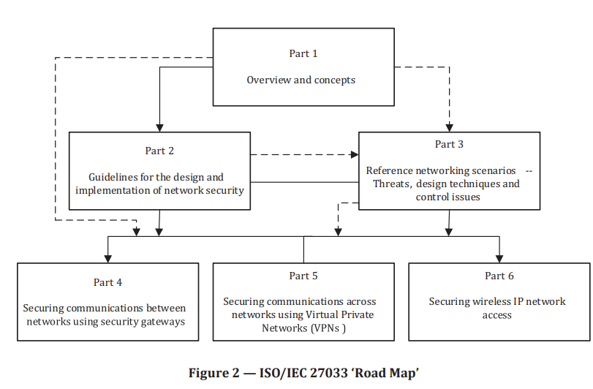
Network Standards
ISO-ISO/IEC 27033
Structure
for any organization starting from ‘scratch’, or conducting a major review of existing network(s), it should first use the content of Part 1 and then Part 2, but consulting as necessary and appropriate the information on security risks, design techniques and control issues contained in Parts 3 to 6.
For example, an organization is considering the implementation of a new network environment that includes use of IP convergence, security gateways and some use of wireless, as well as use of web hosting and the Internet (e.g. for email and outgoing online access).

Slide 41
Network Standards
ISO-ISO/IEC 27033
In using the processes described in Part 1 to determine the security risks to the new network environment, the organization would consult the risk related information from the other relevant Parts of ISO/IEC 27033, i.e. those Parts that define the specific security risks (as well as design techniques and control issues) relating to IP convergence, security gateways and some use of wireless, as well as use of web hosting and the Internet (e.g. for email and online access).
In using Part 2 to determine the network technical security architecture required, the organization would consult the information on design techniques and control issues from the other relevant Parts of ISO/IEC 27033, i.e. those that define the specific design techniques and control issues (as well as the security risks) - relating to IP convergence, security gateways and some use of wireless, as well as use of web hosting and the Internet (e.g. for email and online access).
The structure of this standard comprises:
— an overview of the approach to network security
— a summary of the process for identifying network related risks and preparing to identify security controls, i.e. establishing network security requirements

Slide 42
Network Standards
ISO-ISO/IEC 27033
— an overview of the controls that support network security technical architectures and their related technical controls, i.e. other controls (non-technical and technical) that are applicable not just to networks
— an introduction to the achievement of quality technical security architectures that will ensure network security appropriate to organizations’ business environments, using a consistent approach to the planning for and design of network security, as relevant aided by the use of models/frameworks
— an introduction to the specific risks, design, techniques and control issues associated with reference network scenarios
— an introduction to the specific risks, design techniques and control issues for network ‘technology’ topics
— a summary of the issues associated with developing, implementing and testing a network security solution operating a network security solution and the on-going monitoring and reviewing of a network security implementation
— a table that shows cross-references between ISO/IEC 27001/27002 network security related controls

Slide 43
Network Standards
ISO-ISO/IEC 27033
The overall process for achieving and maintaining required network security can be summarized as follows:
determine scope/context and then assess security risks:
— gather information on the current and/or planned network environment:
— review the corporate information security policy for statements on network related risks that will always be considered as high, and on network security controls that will need to be implemented regardless of the assessed risks.
— gather and review information on the current and/or planned network(s) – the architecture(s), applications, services, types of connection and other characteristics – this will have a bearing on the identification and assessment of risks, and determining what is possible in terms of network technical security architecture/design,
— gather other information to be able to assess potential adverse business impacts, threats and vulnerabilities (this will include the value to business operations of the information to be transferred via network connections, any other information potentially accessible in an unauthorized way through these connections, and of the services provided),
identify and assess the network security risks, and appropriate potential control areas:
— conduct network security risk assessment and management review including using risk information related to required network scenarios and ‘technology’ topics

Slide 44
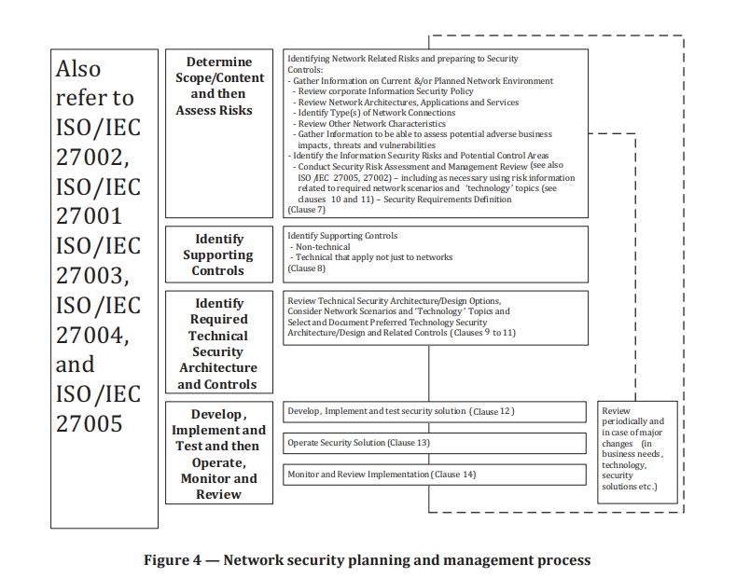
Network Standards
ISO-ISO/IEC 27033
b) identify supporting security controls – non-technical and technical that not only apply to networks
c) review technical security architecture/design options, considering network scenarios and ‘technology’ topics, and selecting and documenting the preferred technical security architecture/design and related security controls
d) develop and test the security solution
e) implement and operate the security controls
f) monitor and review the implementation

Slide 45
Network Standards
ISO 8877
This International Standard specifies the 8-pole connector (plug and jack) and the assignments of poles/contacts for use in physical interfaces of Integrated Services Digital Network (ISDN) basic access arrangements.
These physical interfaces, where they exist, will be located at reference points S and T between TEs and NTs and between NTls and NT2s and shall conform to CClTT Recommendation
pole: A position for a contact.
contact: The electrical contact element which, for many connectors, is referred to as a "pin".
plug and jack: The male and female connector parts,
8 pole plugs and jack are specified for the interconnection of TES and NTs. One plug and jack pair is used to connect the TE connecting cord to the interface and a second plug and jack pair is used to connect the NT connecting cord to the interface cable
Interface cabling may have a passive bus of a point-to-point configuration

Slide 46
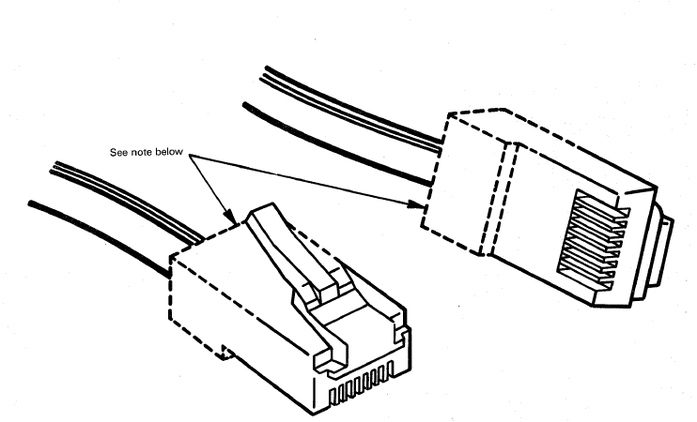
Network Standards
ISO 8877
TE and NT connecting cords shall be terminated in plugs.
The number of physical contacts provided or required is dependent upon the use by the associated equipment, TE or NT, of the optional provisions for powering across the interface.

Slide 47
Network Standards
ISO 8877

Slide 48
Network Standards
ISO 11801
Within customer premises, the importance of the cabling infrastructure is similar to that of other fundamental building utilities such as heating, lighting and mains power. As with other utilities, interruptions to service can have a serious impact. Poor quality of service due to lack of design foresight, use of inappropriate components, incorrect installation, poor administration or inadequate support can threaten an organisation's effectiveness.
Historically, the cabling within premises comprised both application specific and multipurpose networks. The original edition of this standard enabled a controlled migration to generic cabling and the reduction in the use of application-specific cabling.
The subsequent growth of generic cabling designed in accordance with ISO/IEC 11801 has
contributed to the economy and growth of Information and Communications Technology (ICT),
b) supported the development of high data rate applications based upon a defined cabling model, and c) initiated development of cabling with a performance surpassing the performance classes specified in ISO/IEC 11801:1995 and ISO/IEC 11801 Ed1.2:2000.

Slide 49
Network Standards
ISO 11801
This International Standard provides:
users with an application independent generic cabling system capable of supporting a wide range of applications;
b) users with a flexible cabling scheme such that modifications are both easy and economical;
c) building professionals (for example, architects) with guidance allowing the accommodation of cabling before specific requirements are known; that is, in the initial planning either for construction or refurbishment;
d) industry and applications standardization bodies with a cabling system which supports current products and provides a basis for future product development.

Slide 50
Network Standards
ISO 11801
This International Standard specifies a multi-vendor cabling system which may be implemented with material from single and multiple sources, and is related to:
international standards for cabling components developed by committees of the IEC, for example copper cables and connectors as well as optical fibre cables and connectors
b) standards for the installation and operation of information technology cabling as well as for the testing of installed cabling
c) applications developed by technical committees of the IEC, by subcommittees of ISO/IEC JTC 1 and by study groups of ITU-T, for example for LANs and ISDN;
d) planning and installation guides which take into account the needs of specific applications for the configuration and the use of cabling systems on customer premises(ISO/IEC 14709 series).
Physical layer requirements for the applications listed in Annex F have been analysed to determine their compatibility with cabling classes specified in this standard. These application requirements, together with statistics concerning the topology of premises and the model described, have been used to develop the requirements for Classes A to D and the optical class cabling systems. New Classes E and F have been developed in anticipation of future network technologies.

Slide 51
Network Standards
ISO 11801
As a result, generic cabling defined within this International Standard
specifies a cabling structure supporting a wide variety of applications,
b) specifies channel and link Classes A, B, C, D and E meeting the requirements of standardised applications,
c) specifies channel and link Classes E and F based on higher performance components to support the development and implementation of future applications,
d) specifies optical channel and link Classes OF-300, OF-500, and OF-2000 meeting the requirements of standardised applications and exploiting component capabilities to ease the implementation of applications developed in the future,
e) invokes component requirements and specifies cabling implementations that ensure performance of permanent links and of channels that meet or exceed the requirements for cabling classes,
f) is targeted at, but not limited to, the general office environment.

Slide 52
Network Standards
ISO 11801 - SCOPE
ISO/IEC 11801 specifies generic cabling for use within premises, which may comprise single or multiple buildings on a campus.
It covers balanced cabling and optical fibre cabling.
ISO/IEC 11801 is optimised for premises in which the maximum distance over which telecommunications services can be distributed is 2 000 m.
The principles of this International Standard may be applied to larger installations.
Cabling defined by this standard supports a wide range of services, including voice, data, text, image and video.
This International Standard specifies directly or via reference the:
a) structure and minimum configuration for generic cabling,
b) interfaces at the telecommunications outlet (TO),
c) performance requirements for individual cabling links and channels,
d) implementation requirements and options,
e) performance requirements for cabling components required for the maximum distances specified in this standard,
f) conformance requirements and verification procedures.

Slide 53
Network Standards
ISO 11801 - SCOPE
Safety (electrical safety and protection, fire, etc.) and Electromagnetic Compatibility (EMC) requirements are outside the scope of this International Standard, and are covered by other standards and by regulations

Slide 54
Network Standards
ISO 11801 - Structure of the generic cabling system
This clause identifies the functional elements of generic cabling, describes how they are connected together to form subsystems and identifies the interfaces at which application specific components are connected to the generic cabling.
Functional elements : The functional elements of generic cabling are as follows:
campus distributor (CD);
campus backbone cable;
building distributor (BD);
building backbone cable;
floor distributor (FD);
horizontal cable;
consolidation point (CP);
consolidation point cable (CP cable)
multi-user telecommunications outlet (MUTO);
telecommunications outlet (TO).
Groups of these functional elements are connected together to form cabling subsystems

Slide 55
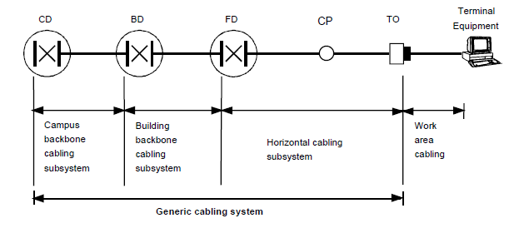
Network Standards
ISO 11801 - Cabling subsystems
Generic cabling systems contain up to three cabling subsystems: campus backbone, building backbone and horizontal cabling.
The distributors provide the means to configure the cabling to support different topologies like bus, star and ring.
Campus backbone cabling subsystem
The campus backbone cabling subsystem extends from the campus distributor to the building distributor(s), usually located in separate buildings
When present, the subsystem includes:
the campus backbone cables;
any cabling components within the building entrance facilities;
jumpers and patch cords in the campus distributor;
the connecting hardware on which the campus backbone cables are terminated (at both the campus and building distributors).
Where the building distributor does not exist, the campus backbone cabling subsystem extends from the campus distributor to the floor distributor.

Slide 56
Network Standards
ISO 11801 - Building backbone cabling subsystem
A building backbone cabling subsystem extends from building distributor(s) to the floor distributor(s).
When present, the subsystem includes:
the building backbone cables;
jumpers and patch cords in the building distributor;
the connecting hardware on which the building backbone cables are terminated (at both the building and floor distributors).
The subsystem includes:
• the horizontal cables;
• jumpers and patch cords in the floor distributor;
• the mechanical termination of the horizontal cables at the telecommunications outlet;
• the mechanical termination of the horizontal cables at the floor distributor including the
connecting hardware, for example of the interconnect or cross-connect;
• a consolidation point (optional);
• the telecommunications outlets.
Horizontal cabling subsystem
The horizontal cabling subsystem extends from a floor distributor to the telecommunications outlet(s) connected to it.

Slide 57
Network Standards
ISO 11801 - Horizontal cabling subsystem
The horizontal cabling subsystem extends from a floor distributor to the telecommunications outlet(s) connected to it.
The subsystem includes:
the horizontal cables;
jumpers and patch cords in the floor distributor;
the mechanical termination of the horizontal cables at the telecommunications outlet;
the mechanical termination of the horizontal cables at the floor distributor including the connecting hardware, for example of the interconnect or cross-connect;
a consolidation point (optional);
the telecommunications outlets.
Horizontal cables shall be continuous from the floor distributor to the telecommunications outlets unless a consolidation point is installed

Slide 58
Network Standards
ISO 11801 - Design objectives
Horizontal cabling should be designed to support the broadest set of existing and emerging applications and therefore provide the longest operational life.
This will minimise disruption and the high cost of recabling in the work area.
Building backbone cabling should be designed for the entire life of the generic cabling system.
However, it is common to adopt short-term approaches that support current and foreseeable application requirements, particularly where there is good physical access to pathways.
The selection of campus backbone cabling may require a longer-term approach than that adopted for the building backbone, particularly if access to pathways is more limited.
Interconnection of subsystems
In generic cabling, the functional elements of the cabling subsystems are interconnected to form a hierarchical structure

Slide 59
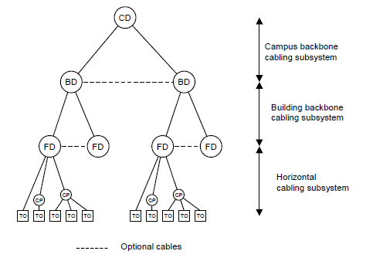
Network Standards
ISO 11801 - Interconnection of subsystems
In generic cabling, the functional elements of the cabling subsystems are interconnected to form a hierarchical structure

Slide 60
Network Standards
ANSI/TIA/EIA-569-B-Purpose
As the complexity of voice and data telecommunications has increased, standards have been established to ensure the operability, flexibility, manageability and longevity of these critical commercial support systems.
Telecommunications now encompasses voice, data and video transmission of business information, fire and security, audio, environmental and other intelligent building controls over media that includes fiber optics, specialized copper data cabling, microwave and radiowave.
describes the architectural design elements of cabling pathways and dedicated rooms for telecommunications equipment.
A multi-tenant commercial building has a life expectancy of at least 50 years.
Software, hardware and communications gear have far shorter lifespans of one to five years.
Moreover, in a multi-tenant environment, continuous moves, adds and changes are inevitable.
It is the purpose of standards to guide design and ease future changes by planning for the future now.
These standards are intended to provide for a generic structured cabling plant, capable of running any voice or data application foreseeable in the next 10 to 15 years.

Slide 61
Network Standards
ANSI/TIA/EIA-569-B- Design Considerations
Entrance facilities include the pathways for outside carrier services, interbuilding backbone, alternate entrance and antennae entrance pathways.
The entrance facilities consist of a termination field interfacing any outside cabling to the intrabuilding backbone cabling.
The local telephone carrier is typically required to terminate cabling within 50 ft of building penetration and to provide primary voltage protection.
In buildings larger than 20,000 usable sq. ft., a locked, dedicated, enclosed room is recommended.
Beyond 70,000 sq. ft., a locked, dedicated room is required, with a plywood termination field provided on two walls.
In buildings up to 100,000 usable sq. ft., a wall-mounted termination field may serve as the entrance facility, using 3/4-inch plywood, 8 ft high.
Beyond 100,000 sq. ft., rack-mounted and free-standing frames may also be required.

Slide 62
Network Standards
ANSI/TIA/EIA-569-B- Design Considerations
Minimum space requirements are given as follows:
Service Entrance Pathways
For underground facilities, use a minimum 4-inch conduit or duct constructed of PVC type B, C or D, multiple plastic duct, galvanized steel, or fiber glass with appropriate encasement.
No more than two 90° manufactured bends are allowed (10 times the diameter).
Drain slope should not be less than 12 inches per 100 ft. Recommended conduit fill varies but should not exceed 40 percent for more than two cables.
Maintenance holes (typically 3,500 lb./sq. in., concrete) must be equipped with sump, corrosion-protected pulling iron, cable racks, grounded ladder and only such power and light conductors as required for telecommunications support per NEC requirements.

Slide 63
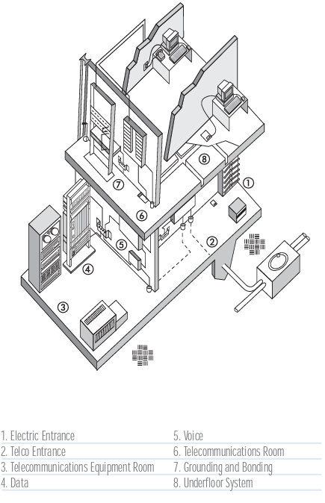

Slide 64
Network Standards
ANSI/TIA/EIA-569-B- Design Considerations
Equipment Room -An equipment room is essentially a large telecommunications room that may house the main distribution frame, PBXs, secondary voltage protection, etc. The equipment room is often appended to the entrance facilities or a computer room to allow shared air conditioning, security, fire control, lighting and limited access
Location -Typically, rooms should be located away from sources of electromagnetic interference (transformers, motors, x-ray, induction heaters, arc welders, radio and radar).
Perimeters-Typically, no false ceiling; all surfaces treated to reduce dust; walls and ceiling painted white or pastel to improve visibility.
Limited Access -Typically, single or double 36” x 80” lockable doors with no doorsills.
Others -Typically, no piping, ductwork, mechanical equipment or power cabling should be allowed to pass through the equipment room. No unrelated storage
Ceiling Height- Minimum clear height in room shall be 8 ft. (2.4 m), the height between the finished floor and the lowest point should be 10 ft. (3 m) to accommodate tall racks and overhead raceways. False ceilings should not be installed.
HVAC- 24 hours a day, 365 days a year, 64° to 75° F, 30 to 55 percent humidity, positive pressure, with independent power from telecommunications equipment..

Slide 65
Network Standards
ANSI/TIA/EIA-569-B- Design Considerations
Equipment Room -An equipment room is essentially a large telecommunications room that may house the main distribution frame, PBXs, secondary voltage protection, etc. The equipment room is often appended to the entrance facilities or a computer room to allow shared air conditioning, security, fire control, lighting and limited access
Location -Typically, rooms should be located away from sources of electromagnetic interference (transformers, motors, x-ray, induction heaters, arc welders, radio and radar).
Perimeters-Typically, no false ceiling; all surfaces treated to reduce dust; walls and ceiling painted white or pastel to improve visibility.
Limited Access -Typically, single or double 36” x 80” lockable doors with no doorsills.
Others -Typically, no piping, ductwork, mechanical equipment or power cabling should be allowed to pass through the equipment room. No unrelated storage
Ceiling Height- Minimum clear height in room shall be 8 ft. (2.4 m), the height between the finished floor and the lowest point should be 10 ft. (3 m) to accommodate tall racks and overhead raceways. False ceilings should not be installed.
HVAC- 24 hours a day, 365 days a year, 64° to 75° F, 30 to 55 percent humidity, positive pressure, with independent power from telecommunications equipment..

Slide 66
Network Standards
TIA 598 C
TIA 942
ITU-T G 992
IEEE 802.3,802.11,802.15

